Slide 1
Effects on Mental Health of Health Care Workers Due to CovID19
Group Members
Mubashir AlI MSDS20085
Qazi Danish Ayub MSDS20075
Abdullah Aziz MSDS20052

Slide 2
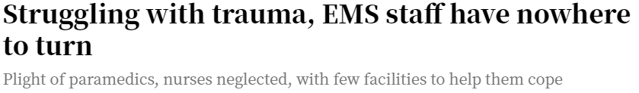
Motivation
Medical workers are the frontline for this fight against a pandemic
During these hard times a lot of other different factors make things more stressful
Non availability of beds, shortage of ICU/Medications
People are out of jobs, businesses are closed, self-isolated with fear of unknown.
People are afraid of going to market, concerned for their family members’ safety and had elevated levels of fear.
Improper lockdown policies
Non-serious attitude of general public about social distancing, sanitization measures
Rising number of cases

Slide 3
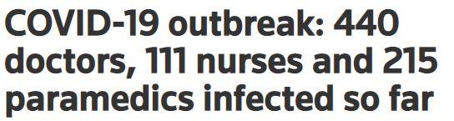

Observations
In other parts of the world an increase in following mental conditions were observed
Anxiety
Insomnia
Depression
Paranoia

Slide 4
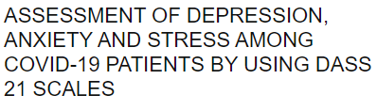
Available Resources
We have well known questionnaire already designed in order to guess the diagnosis.
https://maic.qld.gov.au/wp-content/uploads/2016/07/DASS-21.pdf
Conditions | Questionnaire
Anxiety | 7-item Generalized Anxiety Disorder scale
Depression | 9-item Patient Health Questionnaire
insomnia | 7-item Insomnia Severity Index
Distress | 22-item Impact of Event Scale–Revised
BUT ?

Slide 5
Challenges
Data Collection
Translation of questionnaire
Making survey forms
Picking out the best questions
Designing online surveys

Slide 6
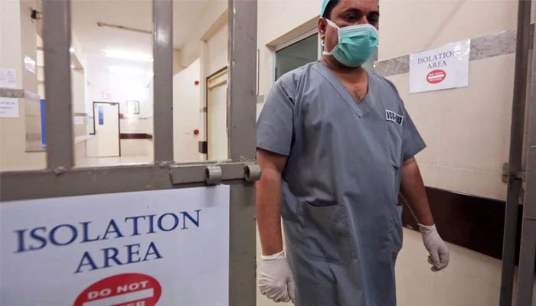
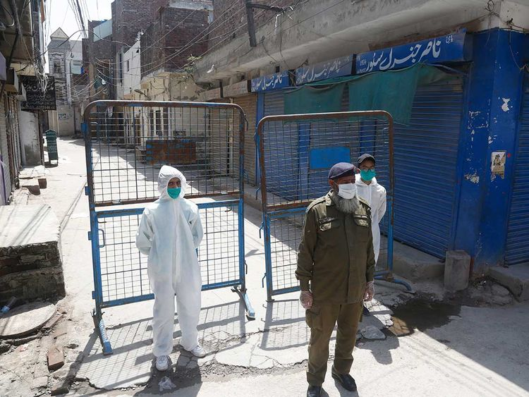
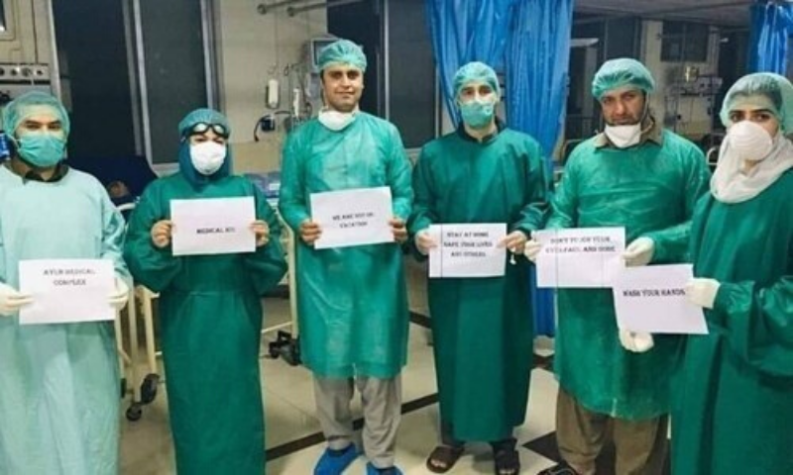
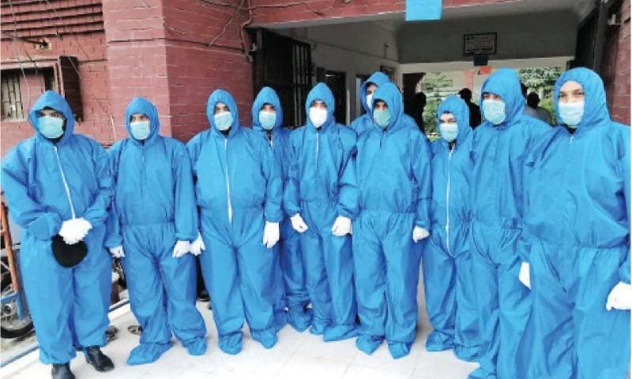
Hypothesis
“Around the globe we have seen the number of people with deteriorating mental health especially among the healthcare sector.”

